Slide 1
BackgroundAnimation
Created By M.Zohaib

Slide 2
Create Basic Html structure
<!DOCTYPE html>
<html lang="en">
<head>
<meta charset="UTF-8">
<meta name="viewport" content="width=device-width, initial-scale=1.0">
<meta http-equiv="X-UA-Compatible" content="ie=edge">
<title>Document</title>
</head>
<body>
</body>
</html>

Slide 3
Add following html in your body tag
<div class='slider'>
<div class='slide1'></div>
<div class='slide2'></div>
<div class='slide3'></div>
</div>

Slide 4
Style .slider class
.slider {
max-width: 300px;
height: 200px;
margin: 20px auto;
position: relative;
}

Slide 5
Styling all classed by selecting all in css group selector
.slider1,.slider2,.slider3,{
position: absolute;
width: 100%;
height: 100%;
}

Slide 6
Now style .slide1
.slide1 {
background: url('b.jpg')no-repeat center;
background-size: cover;
animation:fade 8s infinite;
}

Slide 7

output

Slide 8
Now style .slide2
.slide2 {
background: url('bb.jpeg')no-repeat center;
background-size: cover;
animation:fade2 8s infinite;
}

Slide 9
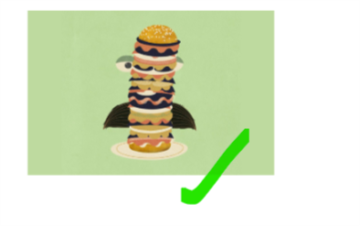
output

Slide 10
Now style .slide3
.slide3 {
background: url('bbb.jpg')no-repeat center;
background-size: cover;
animation:fade3 8s infinite;
}

Slide 11

output

Slide 12
Add @keyframes
@keyframes anim1
{
0% {opacity:1}
33.333% { opacity: 0}
66.666% { opacity: 0}
100% { opacity: 1}
}

Slide 13
@keyframes fade2
{
0% {opacity:0}
33.333% { opacity: 1}
66.666% { opacity: 0 }
100% { opacity: 0}
}

Slide 14
@keyframes fade3
{
0% {opacity:0}
33.333% { opacity: 0}
66.666% { opacity: 1}
100% { opacity: 0}
}

